Slide 1


Plant Desease Detection System For Substainable Agriculture

Slide 2

Learning Objectives
Understand the application of CNNs in image-based classification tasks.
Learn how to preprocess image datasets and apply augmentation.
Gain experience working with Google Colab and integrating Python scripts.
Build a complete AI pipeline from data collection to real-world deployment.
Understand the societal impact of AI in agriculture.
GOAL
Source :
www.freepik.com/

Slide 3
Tools and Technology used
Python
Google Colab
TensorFlow / Keras (for CNN model)
OpenCV (for image processing)
Google Drive (for dataset storage)
Streamlit / Tkinter (for GUI - optional deployment)
PlantVillage Dataset (or similar dataset)

Slide 4
Methodology
Data Collection & Organization – Curated leaf images for different crops and diseases.
Uploading Dataset – Used Google Drive and Colab for seamless access and training.
Image Preprocessing & Augmentation – Resized, normalized, and augmented images for better generalization.
CNN Model Development – Built a deep learning model tailored for plant disease classification.
Model Evaluation – Tested on unseen data to ensure accuracy and robustness.
Deployment – Developed a user-friendly interface for farmers to interact with the model.

Slide 5
Problem Statement:
In agriculture, plant diseases can cause major damage to crops, leading to reduced yields and economic losses for farmers. Identifying these diseases early is critical—but the traditional method of manual inspection is often slow, inaccurate, and not accessible to everyone, especially in rural areas.
With the rise of affordable smartphones and advancements in artificial intelligence, there’s a great opportunity to make disease detection faster, easier, and more accurate. Our goal is to develop a Plant Disease Detection System that uses deep learning and image processing to automatically identify plant diseases from leaf images.
This system will allow farmers to simply take a photo of a leaf and instantly know whether the plant is healthy or affected by a disease. By making early detection easier and more accessible, we aim to support smarter farming decisions, reduce unnecessary pesticide use, and promote sustainable agriculture.

Slide 6
Solution:
Our solution is a deep learning–based mobile-compatible system that can detect plant diseases from leaf images with high accuracy. The user uploads an image of a leaf, and the system processes the image to predict if the plant is healthy or infected, and specifies the type of disease if present.
This solution leverages Convolutional Neural Networks (CNNs) for robust image classification. It is designed to work on smartphones and desktop platforms using a Python-based interface for ease of use, particularly for farmers and agricultural professionals.

Slide 7
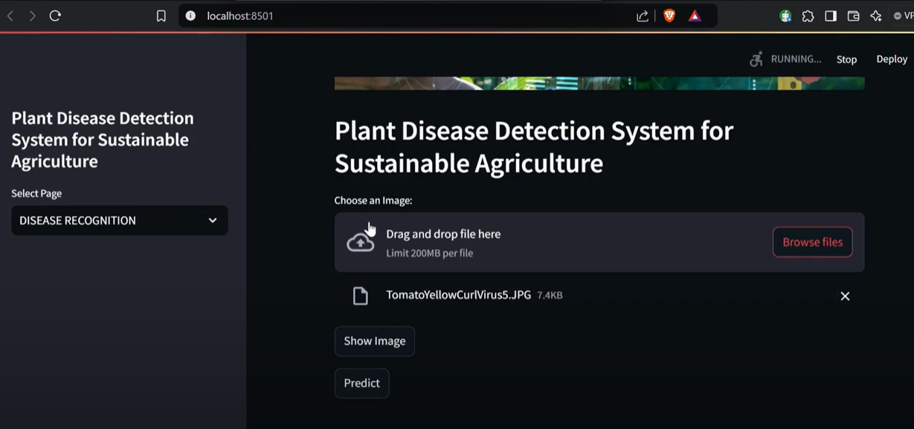
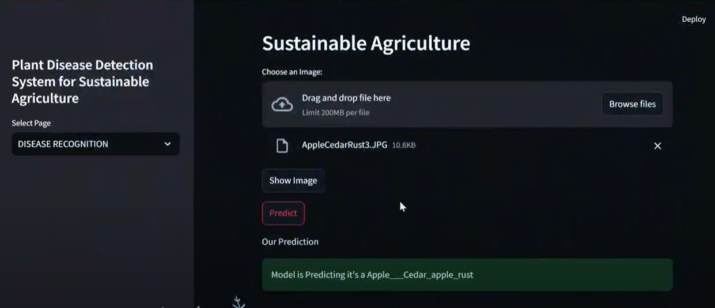
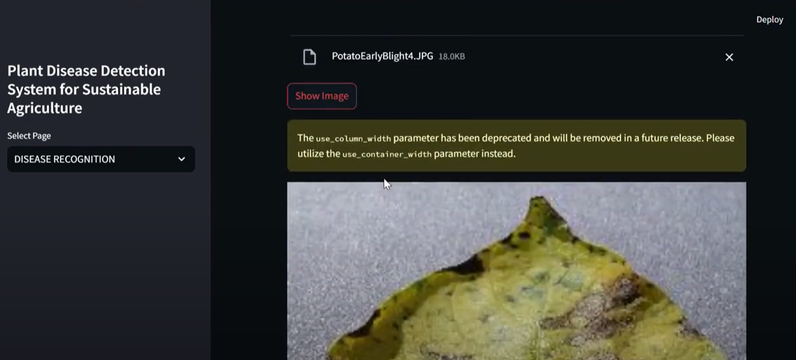
Screenshot of Output:

Slide 8
Conclusion:
Our Plant Disease Detection System shows that AI can be a powerful tool in agriculture. By accurately diagnosing plant diseases from leaf images, the model assists farmers in taking timely action. It reduces reliance on manual inspection, promotes sustainability, and ensures better crop yield. The success of this project demonstrates how technology can be effectively used to solve real-world problems and support rural communities.

